Slide 1
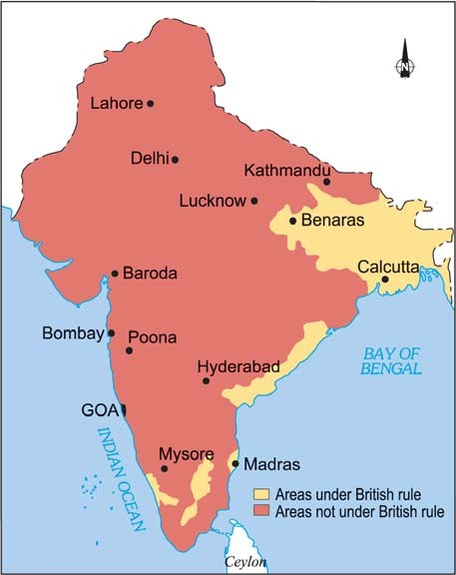
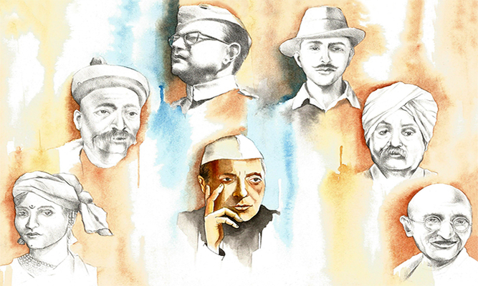
Glimpses of the Past Module 3
From Our Freedom Movement
S D SAWANT

Slide 2
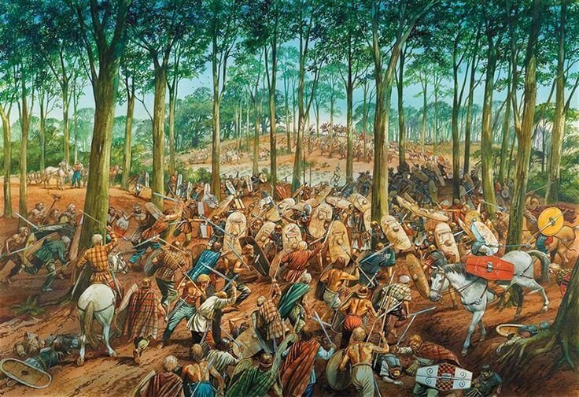
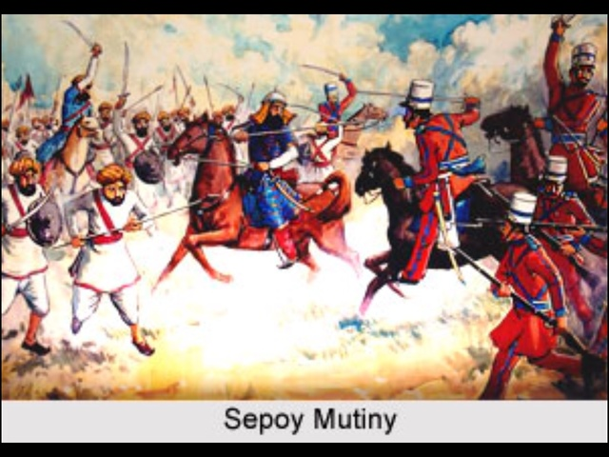
7. The Sparks (1855-57) (Contd.)
In Bengal , the Santhals rose in rebellion and massacred Europeans and their supporters alike.
Discontent was brewing in the East India Company’s army too. Sepoy Mangal Pandey attacked the adjutant of his regiment and was executed. Thousands of other sepoys revolted. They were humiliated and put in irons.
Englishmen hardly cared for the sentiments and customs of the Indians and hence the masses rendered all help and shelter to the patriots.

Slide 3
8. Revolt 1857
There was a violent outbreak at Meerut. The sepoys marched to Delhi. The rebellion spread wider. Many landlords had lost their lands because of British policies and they were sore.

Slide 4
The sepoys marched to Delhi and hailed long live their Emperor Bahadur Shah Zafar . Bahadur Shah II (24 October 1775 – 7 November 1862) was the last Mughal Emperor.

Slide 5
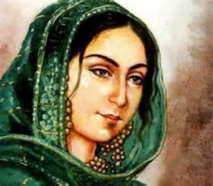
9. The Fight for Freedom (1857)
Begum Hazrat Mahal
1. Many former rulers like Begum Hazrat Mahal of Lucknow were bitter. The white men had taken away her kingdom. They joined the upsurge against the foreigner.

Slide 6
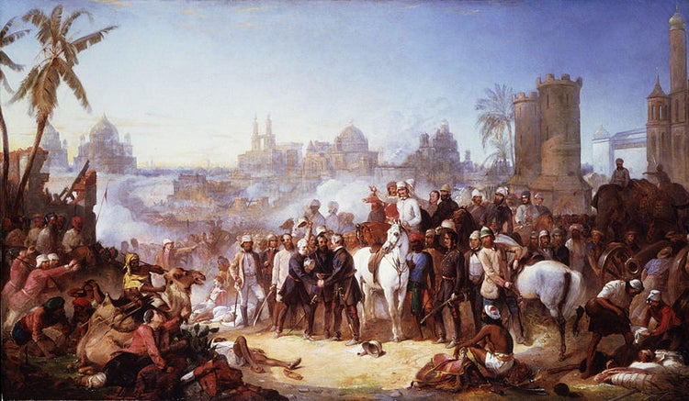
2. Popular leaders like Maulvi Ahmedulla of Faizabad told people to rise and unify and raise their voice against the Angrez who were ruining their lands. The people rose everywhere, in Bareily, Kanpur and Allahabad.

Slide 7
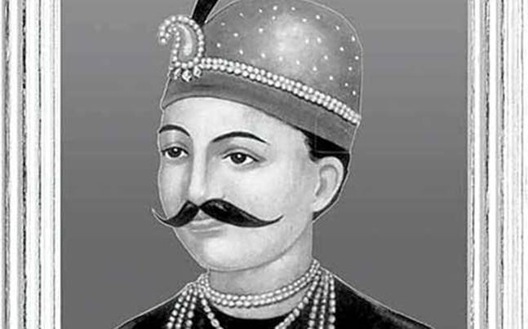
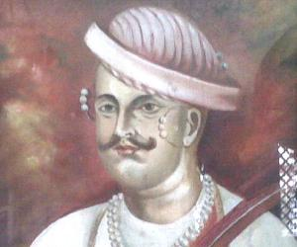
Azimullah Khan told Tantya Tope (a general in the Indian Rebellion of 1857 and one of its notable leaders. Despite lacking formal military training, Tatya Tope is widely considered as the best and most effective rebel general of the Indian mutiny) that they should have Peshwa Nana Saheb as their leader in the war of Independence.
Peshwa Nana Saheb Nana Sahib (19 May 1824 – 1859), born as Dhondu Pant, was an Indian Peshwa of the Marathe empire. An aristocrat and fighter, he led the rebellion Cawnpur (Kanpur) during the 1857 uprising.
The patriots pounced upon the British and fought pitched battles all over North India.
Tantya Tope
Peshwa Nana Saheb

Slide 8
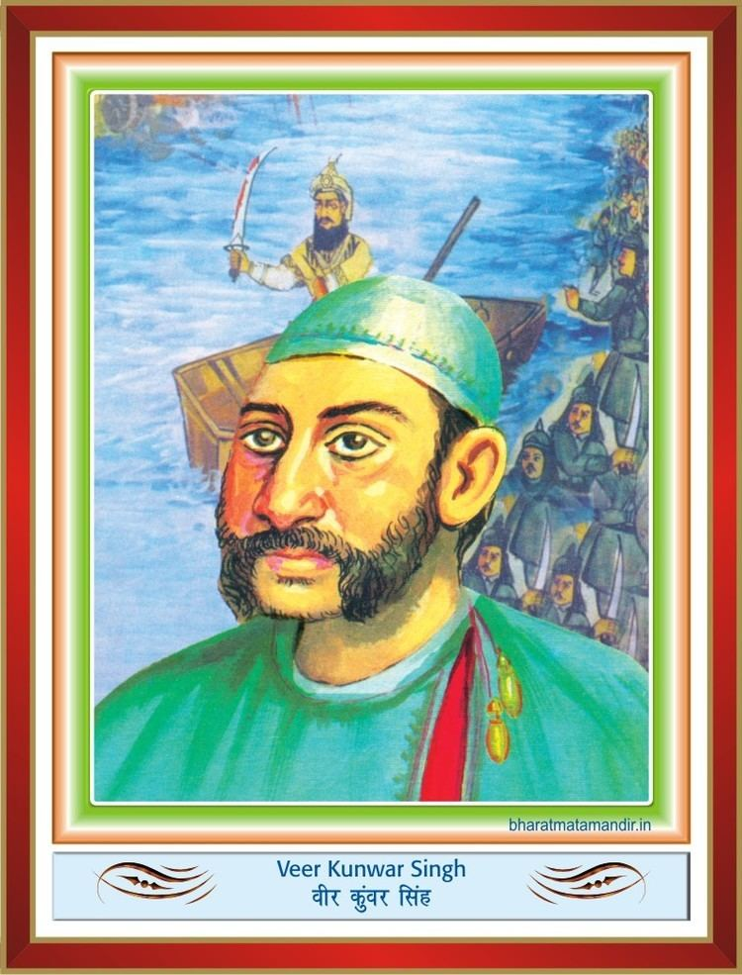
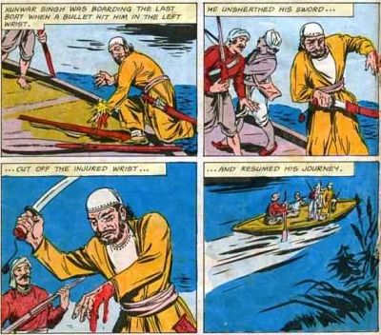
4. Eighty year old Kunwar Singh of Bihar received a bullet in his wrist. He unsheathed his sword, cut off his injured wrist and offered it to Mother Ganga.

Slide 9
Exercise for Practice
1. Which picture, according to you, reveals the first sparks of the fire of revolt ?
2. Name any two popular leaders who led the revolt.
3. Mention four reasons for the discontent that led to the 1857 War of Independence.
4.Who was the Last Mughal Emperor?
5. In what ways did the British officers exploit Indian soldiers working in East India Company’s army?

Slide 10
Multiple Choice Questions
In 1855 in Bengal the _______ rose in rebellion and massacred Europeans and their supporters alike.
(i). Sentinilese
(ii). Santhals
(iii). Red Indian
2. ________ attacked the adjutant of his regiment and was executed.
(i). Chandra Shekhar Azad
(ii). Mangal Pandey
(iii). Bhagat Singh

Slide 11
3. The last Mughal Ruler of India was _______
(i). Bahadur Shah Zafar
(ii). Aurangzeb
(iii). None of the above
4. Many landlords in India were sore because____
(i). They had lost their lands due to british policies.
(ii). They had lost their lands due to drought.
(iii). Both (i) and (ii)

Slide 12
5. Begum Hazrat Mahal was bitter against british because ___
(i). The white men had taken away her kingdom
(ii). The white men had deceived her in the goods received from England.
(iii). Neither (i) nor (ii)
6. The lesson ‘Glimpses of the Past’ is compiled by____
(i). S D Sawant
(ii). Roosevelt
(iii). Ruskin Bond

Slide 13
End of Module 3

